Slide 1

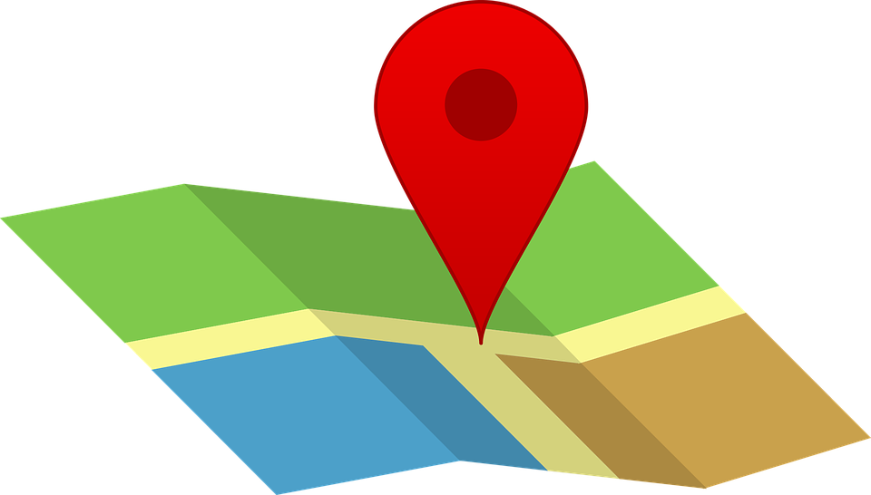
GBC Navigation App
T32
Talha Sultan, Jason Thai
Research project by Professor Jawad Butt
Mentor : Professor Mike Denton

Slide 2
Project Description
Current problems navigating in and out of campus
Solution:
An application that helps new students or visitors to guide to and within the Casa Loma campus by selecting parking areas located around the campus.

Slide 3
In Scope
Draw DESTINATION route on map / blueprint based on ORIGIN
Using static origin / destination coordinates stored in the database
GPS to determine whether user is within the vicinity of the campus.

Slide 4
Out of Scope
Intended ONLY for visitors and George Brown students
CANNOT be used for locations outside of the area of the Casa Loma campus
MUST be online to use the application

Slide 5
MOCKUP DEMO

Slide 6


Technology Requirements ( Front End )
Angular ( Framework)
Opensource framework for Java script
Supports Single Page Applications ( no re-rendering )
MVC architecture, ensures higher reusability of components across the application.
Two-way binding reduces to write additional code so the Model and View can be synchronized easily.
Many libraries that support the framework ( e.g; Material Design )
TypeScript ( Programming Language )
TypeScript allows for static typing to prevent dynamic typing issues on JavaScript
Capability of object-oriented principles
Platform independent without needing to compile the code.
Rich interface – easy to handle events, in our case: selecting the buildings, rooms and parking lots via clicking on images. ( Having to write less code to prevent errors or bugs )

Slide 7

Technology Requirements cont. ( Front End )
NativeScript ( Framework for mobile )
Already integrated with Angular ( can focus on Angular code )
CSS compliant
Use native components and has access to native device API Uses XML based markup language similar HTML ( Cross platform )
Live syncing of code changes during development

Slide 8

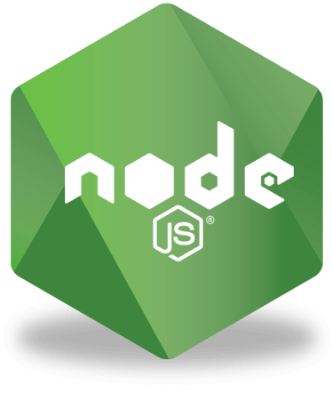

Technology Requirements ( Back End )
MongoDB ( Database )
No schema required and no complex joins
No complex joins
It is easy to scale
Enables faster access of data
The team members are fresh and familiar with the technology as we just learned it.
Node.js ( JavaScript Runtime Environment )
Extended support for various tools ( e.g; libuv for event loops )
Handles many requests simultaneously ( asynchronous )
Express.js ( Node.js Framework )
Built in support for routing and various HTTP configurations and routing
Designed for Single Page Application

Slide 9
In Detailed Technology Requirements
Front End
Using Angular Material Design / NativeScript for a user-friendly experience ( Bound to change )
Backend
Interior / exterior routes and database is requesting and querying stored static coordinates from ORIGIN and DESTINATION points via MongoDb, Node.js or Express.js

Slide 10
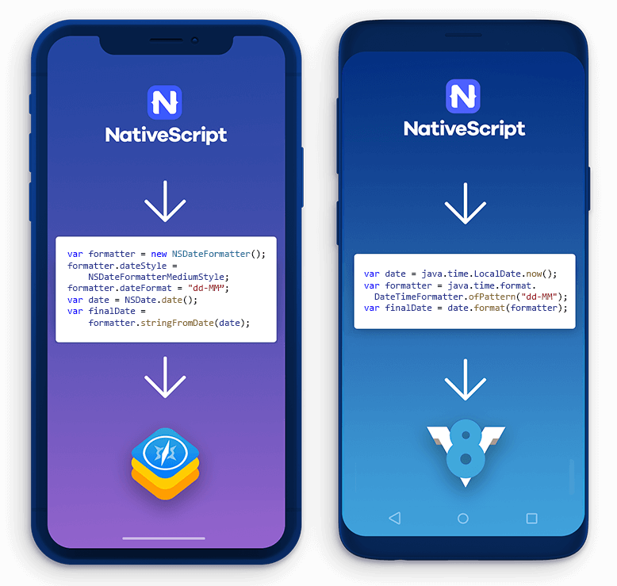
Next Steps / Conclusion
Learning NativeScript
Implementing Express Js
Integrating Angular with NativeScript
Implementation of GPS
Notes:
Consider talking about:
Theoretical computer science
Computer systems
Computer applications
Software engineering

